Slide 1
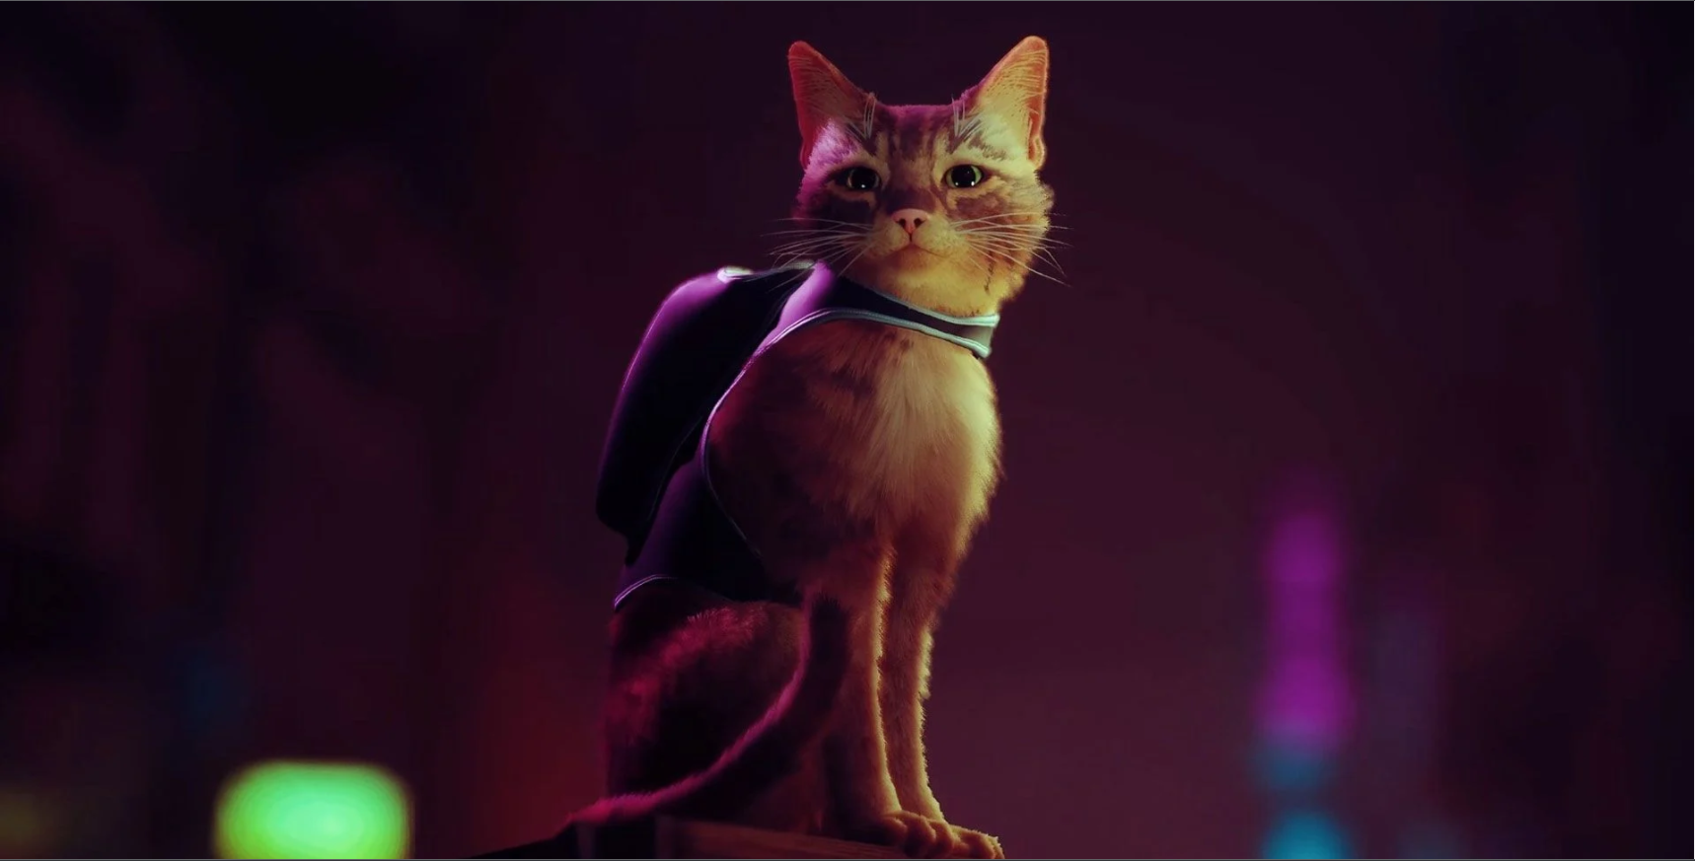
Feral

Slide 2
General Overview
Genre is a 3D puzzle platformer (think of something like Jump King combined with Human Fall Flat)
Various points where players can fall and lose progress
“Safe” points where there is no challenging platforming, but instead a puzzle/task has to be solved

Slide 3
Game Story
Players are thrust into the world through the eyes of Luna, a feral cat living in the heart of New York City
On a mission to rescue recently kidnapped kittens
Simple plot, linear and easy to follow

Slide 4
Game Story Cont.
NOT intended to be a story driven experience
Basic plot points provide fundamental context of the world and the purpose of Luna’s adventure
Emphasis on complimenting the game mechanics through story elements

Slide 5
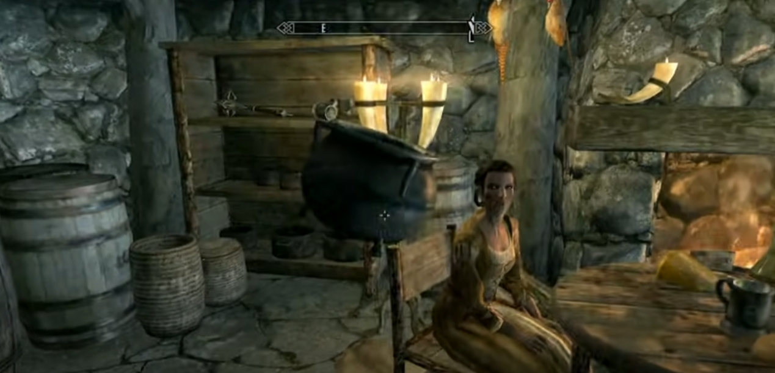
Game Mechanics
Picking up & Holding Objects:
Control: Hold LMB
Description: Allows the player to hold and move various objects within the world. Objects will float directly in front of the player as opposed to having a holding animation.

Slide 6
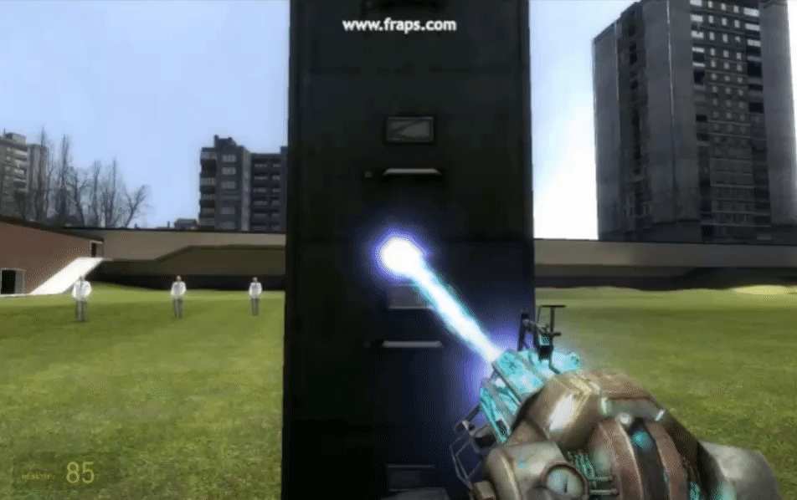
Game Mechanics Cont.
Throwing Objects:
Control: Press RMB
Description: Item being held by the player will be thrown in the direction the player is looking. This mechanic will be important when solving various puzzle challenges. (Throwing items into desired areas, breakable items)

Slide 7
Game Mechanics Cont.
Jumping:
Control: Press SPACE
Description: Players will have 2 jumps (double jump). Jump charges will be recharged when the player collides with the ground.

Slide 8
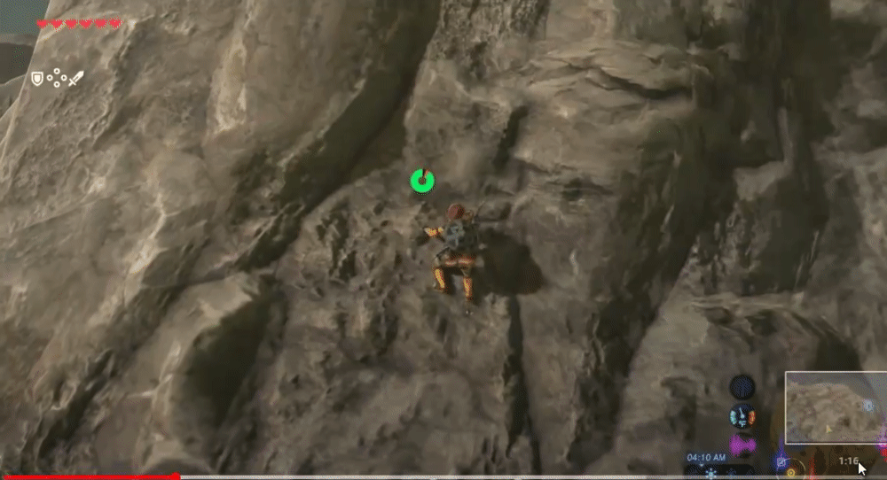
Game Mechanics Cont.
Climbing:
Control: Hold SPACE + Directional Key (WASD)
Description: When colliding with a wall, players can hold SPACE + a directional key to climb. The distance the player will climb will be proportional to there horizontal & vertical velocity when the initial collision takes place.

Slide 9
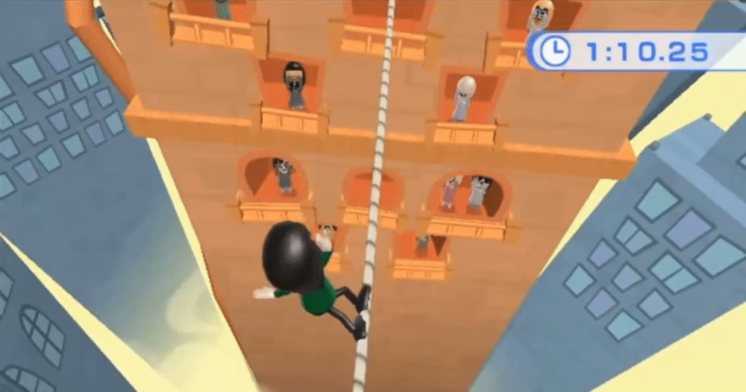
Game Mechanics Cont.
Slacklines/Balancing:
Control: Press A & D
Description: A minigame activity where the player will perform a “balancing act” across tightrope-like terrain. Player will have to use A or D to ensure the character is not leaning too far in one direction.

Slide 10
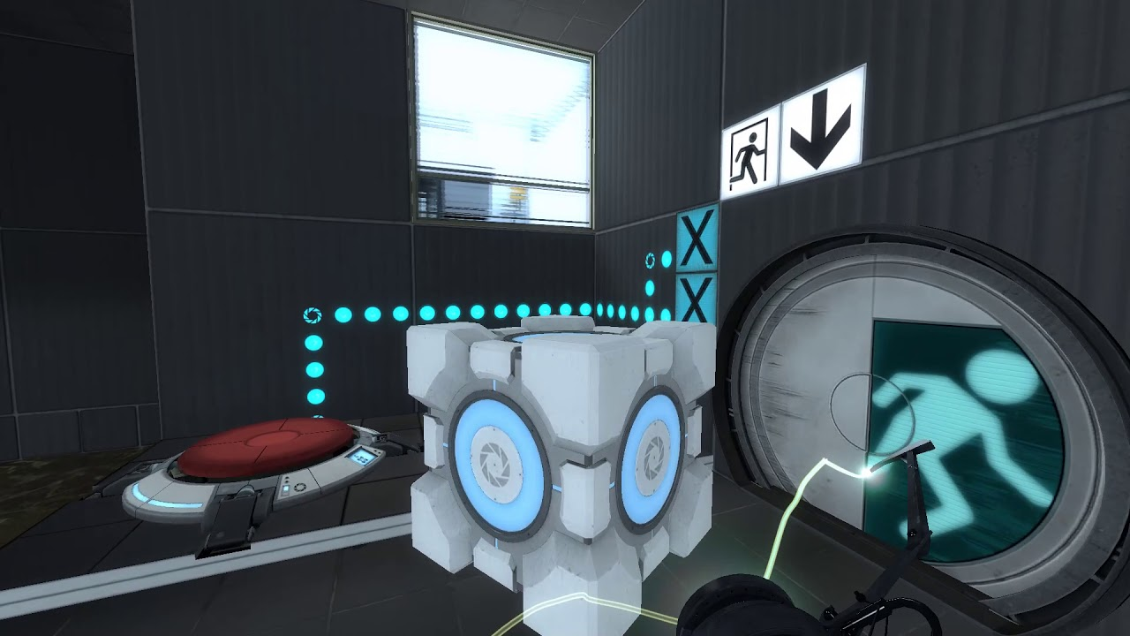
Game Mechanics Cont.
Pressure Plates:
Description: An interactable object in the world that will have a specific behaviour when the correct item is placed on top.

Slide 11
Game Mechanics Cont.
Interactive Doors:
Description: A “barrier” object in the world where the player will have to find various items and or complete difficult tasks to progress further in the game.
Openable by keys/key cards and pressure plates
Displaying the status of the door (ie: Locked, Press ‘E’ to open)

Slide 12
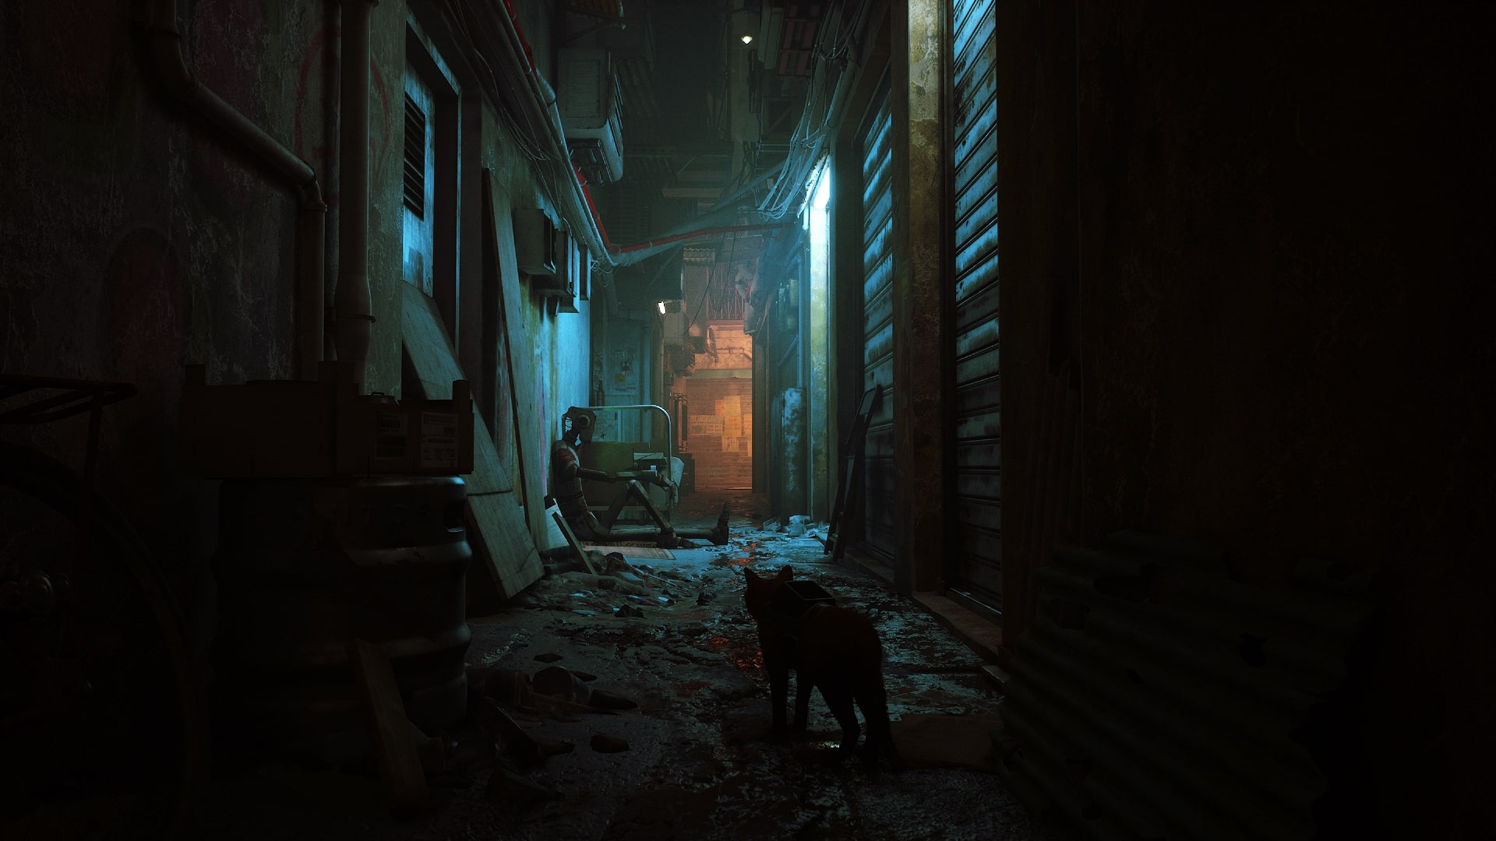
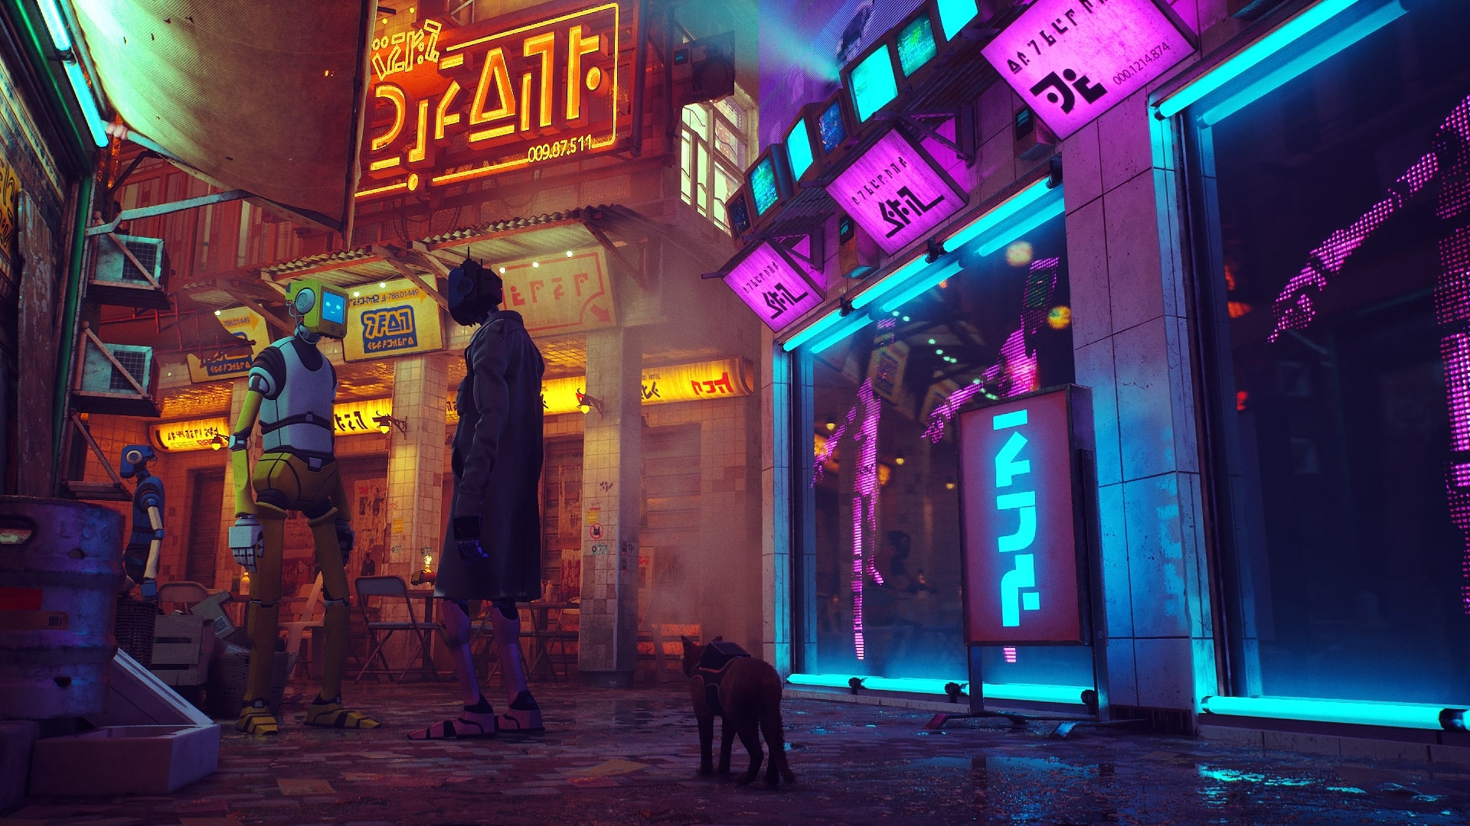
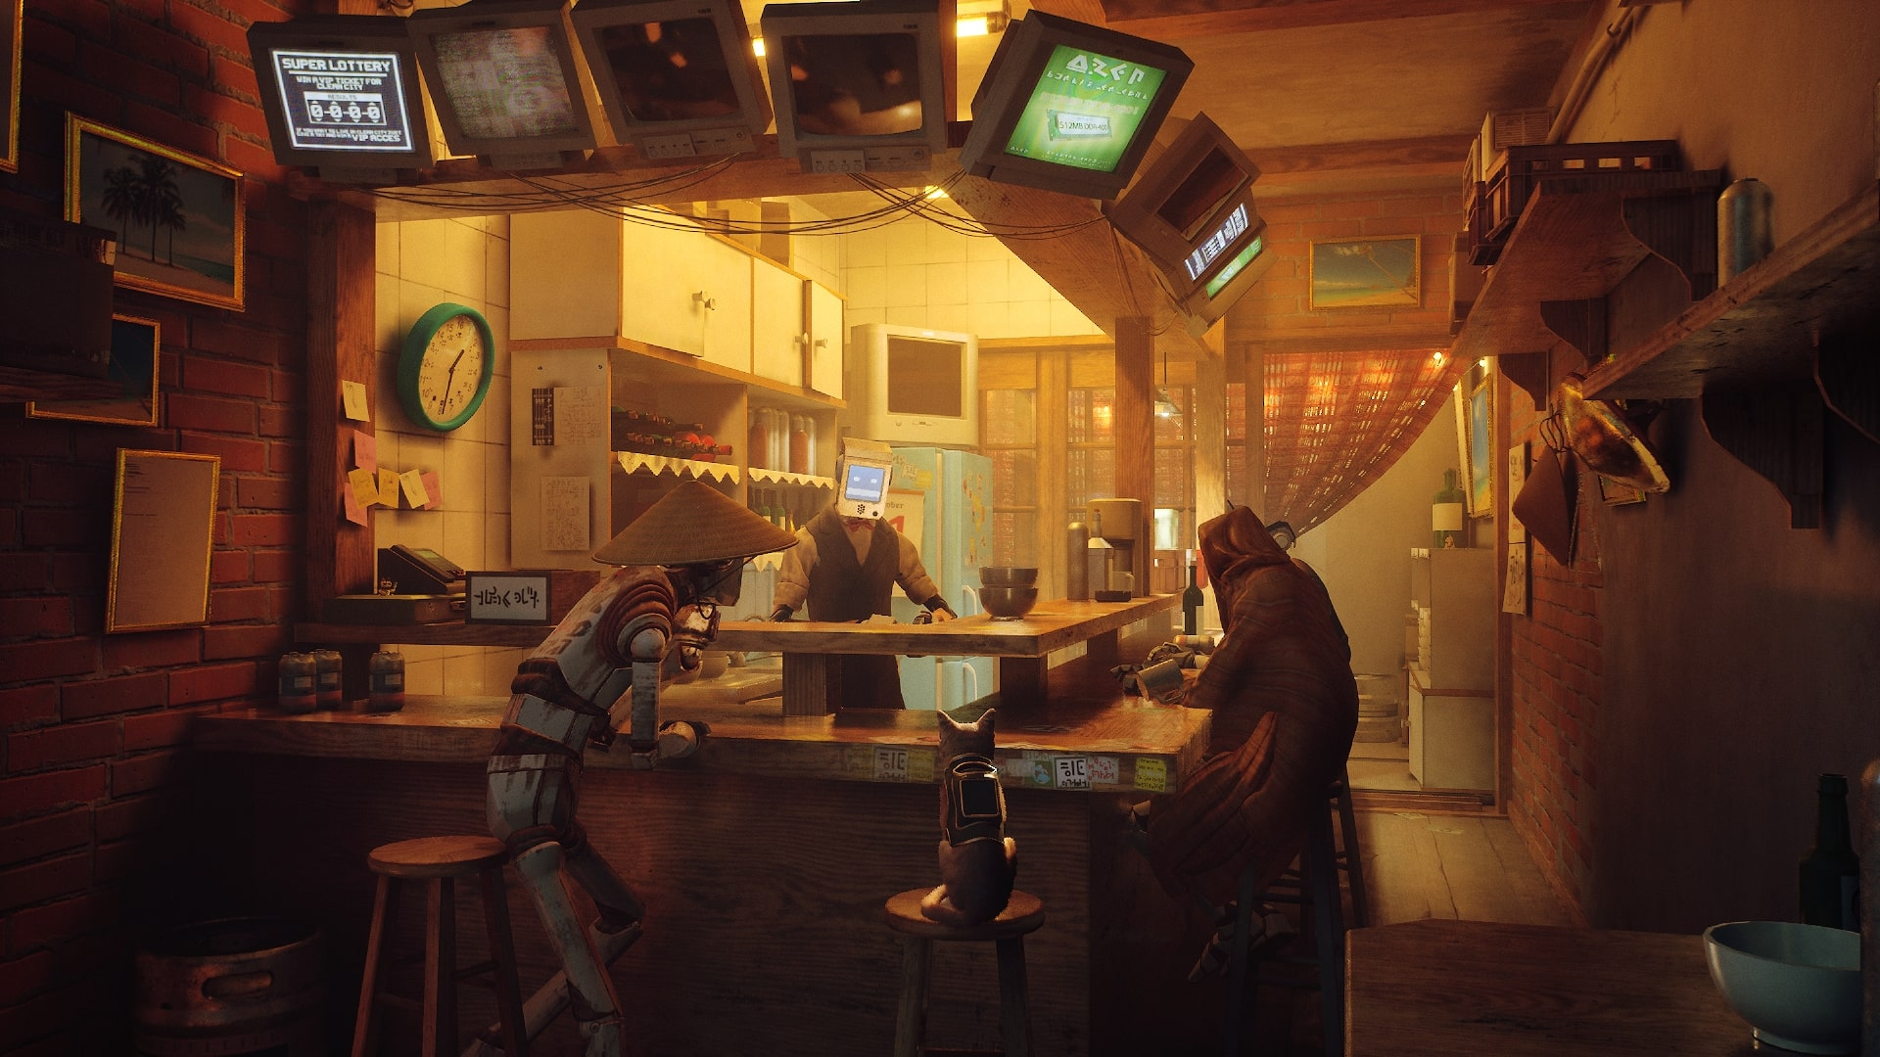
pics

Slide 13
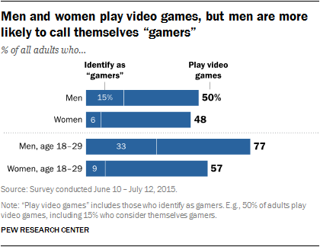
Target Audience
Casual Platformer Fan
Low barrier of entry
Broad subject matter appeal
Higher skill cap
Appeals to more experienced players
May limit accessibility
Via: https://www.pewresearch.org/internet/2015/12/15/who-plays-video-games-and-identifies-as-a-gamer/

Slide 14

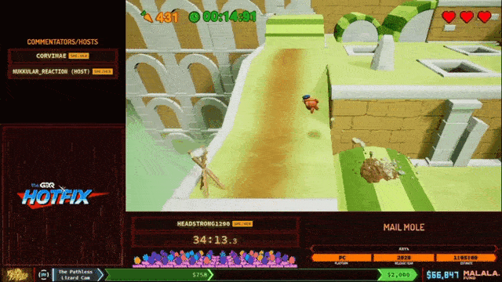
Target Audience Cont.
Speedrunners/Streaming Audience
Gameplay focused on momentum and flexible movement options
Immediately relatable world
High skill cap / Low barrier of entry
Footage via: https://www.youtube.com/watch?v=jeq11f7Ip3s

Slide 15






Monetary Strategy
One Time Purchase
Targeted Retail Price is approx. CDN$15
Comparable to other indie platformer games
* Prices via Steam as of January 2022
Expected Price Range

Slide 16
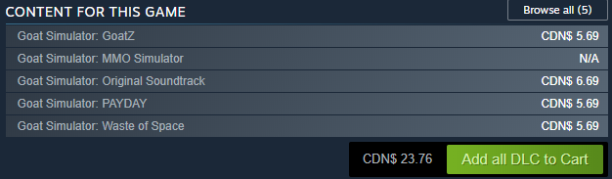
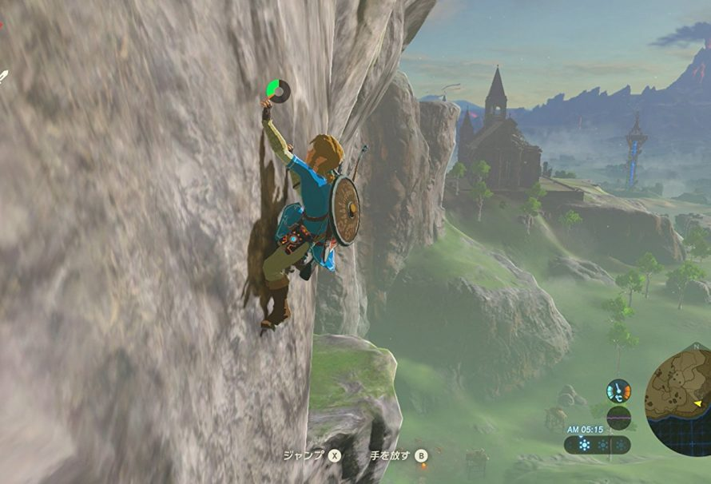
Additional Monetary Considerations
Two potential streams for generating further revenue:
Additional DLC Levels built on top of base game mechanics
Re-use of movement mechanics in a larger title to help offset development costs
Image via: https://www.justpushstart.com/2017/02/legend-zelda-breath-wild-season-pass-dlc-packs/

